Slide 1


You Ever Wonder Why We’re Here?
My First Existential Crisis - The Talk!
Notes:
Howdy - my name is Sarah Christoff, and instead of doing an intro slide I figured it would be more useful for you to tell me why I’m giving this talk.
A couple of months ago, the right of the CFP deadline for KubeCon, my partner and I got in a pretty heated argument. It ended with me being adamant that I would not, and never will submit my CFP to KubeCon because there’s no *way* I could get accepted. After he gave up and headed into the other room I opened up my laptop and submitted my CFP. I would like to say that I did this all out of spite - but at that time I did seriously think “How weird is it people come from all across the world to go to KubeCon, I mean why is kubernetes such a big deal? How does any of this matter?”

Slide 2

Notes:
This led me to bringing up a fifteen year old joke that some of you may be familiar with - or maybe this *is* why most of you showed up today. Sadly I won’t be talking about red vs blue that much.

Slide 3
The 1960s was a crazy time…
Bunch of missile and political stuff happened
Smoking was found to be “hazardous to your health”
Star Trek Debuts
The question “How do I make a computer do two things at a time” was asked
@schristoff25
Notes:
So let’s start with in the 1960s, I wasn’t even born yet but I *think* it was a wild time.
Nixon was president, there was some drama with missles, Star Trek debut and most importantly

Slide 4

How do i make my computer do two things at one time?
Notes:
Someone wanted to make a computer do two things at one time. At this time batch processing was used which was tedious and

Slide 5
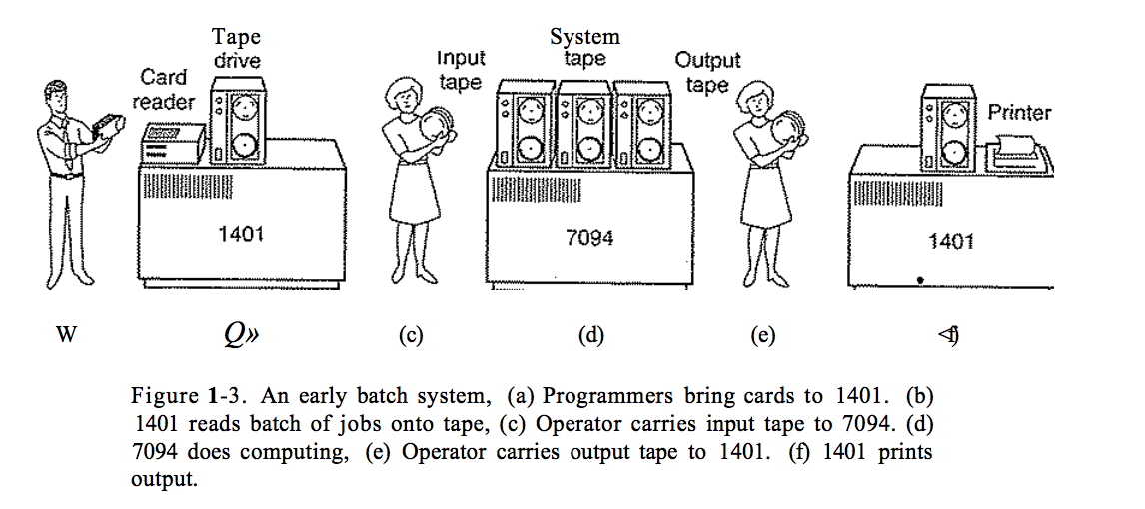
Batch processing
Tanenbaum, Andrew S. Modern Operating Systems: Problem Solutions. Prentice Hall, 1992.
Notes:
used to take forever.
After about an hour of collecting a batch of jobs, the cards were read onto a magnetic tape, which was carried into the machine room, where it was mounted on a tape drive. The operator then loaded up something that was Iike an operating system which read the job from the tape and ran it. After each job finished, the operating system read the next job from the tape and ran it. When the whole batch was done the operator would remove input and output tapes, and brought the output tape to another computer. Because this took so long and was so tedious, there was a lot of downtime.

Slide 6

Batch processing
Source: https://xkcd.com/303/
Notes:
This downtime led us with some unhappy managers, and people wanting computers to be able to do more than one thing at time. This led to the first time sharing operating system being worked on.

Slide 7
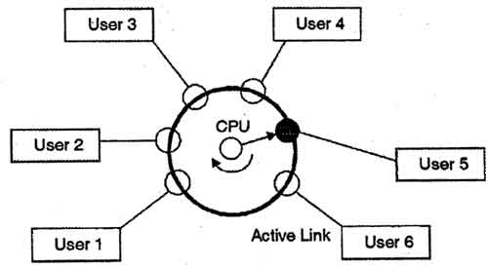
Time sharing
Source: http://www.padakuu.com/article/28-time-sharing-operating-systems
Notes:
Time sharing is when the CPU tries it’s best to divvy up it’s time in between different processes, The time sharing operating system assures that all the tasks get to access the CPU one by one and for a fixed small interval of time. This interval is known as the time quantum. the computer can provide fast, interactive service to a number of users and perhaps also work on big batch jobs in the background when the CPU is otherwise idle”

Slide 8
Where did it begin? - virtual machines
1967
CP-40 designed for Bell Labs
1994
Java is born!
2018
Virtualization is all around me
1963
Project MAC funded by DARPA grant
1969
Work on Unix is started
1999
VMWare Workstation is released
Notes:
In 1963 MIT announced Project MAC, standing for Multiple Access Computer, was funded by a 2 million grant by DARPA. MIT looked at two providers for hardware, GE and IBM. IBM passed on project MAC, thinking batch processing was cool and everyone was satisfied with it, so MIT went with GE.
In 1967, Bell Labs had a similar need, and IBM woke up and created the CP-40, CP standing for control program, which was never sold to customers, but evolved into the CP-67 which was the first commercial mainframe to support virtualization.
In 1969, Progress on Multics, which was supposed to allow multiple users access a mainframe simultaneously, was halted due to Bell labs management being dissatisfied with it. However Ken Thompson who worked on Multics started work on his own operating system, which later became Unix. Unix is cool because it offers virtualization at the user level, meaning multiple users can share the CPU, memory, etc but have their own profiles.
Previous to 1994 users would have to compile all the software they wanted to run, which didn’t give a true portability of software. Java - made by Sun Microsystems, allowed you to write an application once and then run it on any computer with the Java Runtime Environment (JRE). This provided Software Virtualization!
In 1999, VMWare released its Workstation product, a year after the company being founded! Later this product would be distributed freely.
In 2018 virtualization is used everywhere and is an important way on how we increase productivity and security of the systems we run our applications on.

Slide 9

“An efficient, isolated duplicate of
a real computer machine” - popek and goldberg
Notes:
But what is a virtual machine? I always thought this summarized it best, a virtual machine is an efficient isolated duplicate of a real computer machine.

Slide 10
Let’s build our base really quick
I know what a virtual machine is, but someone else might not
Emulation of your computer system
Takes the underlying hardware and plays make believe by letting you configure it into what you want
A hypervisor takes care of the scheduling of these guest operating systems and only sees them as processes
Used to be called Control Program or Virtual Machine Monitors (VMM)
Notes:
Virtual Machines are an emulation of your computer system. It takes the underlying hardware and allows you to partition it to be used in different ways. Instead of just having one box with one OS, we can have one box with many OSes.
It does this virtualization with the help of a hypervisor.
A hypervisor, or virtual machine monitor, takes care of the scheduling of these guest operating systems and only sees them as processes. These processes are typically running in user mode, which means it has restricted access. If a process needs to run in kernel mode, or have unrestricted access, it must talk to the hypervisor.

Slide 11

“Sees them as processes”, that sounds familiar..
Notes:
I know this may sound familiar, but stay with me, a virtual machine is NOT a container

Slide 12
Words that i didn’t know
So you may not too
User Mode
Kernel Mode
Processor executes “normal” instructions
When encountering a privileged instruction, processor switches to kernel mode to preform
Processor executes both normal and privileged instructions
@schristoff25
Notes:
There’s some quick vocabulary we should cover before I go on - mainly because if I had to google it you may have too to, so let me save you some data.
The CPU has a couple different processor modes, usually two, user and kernel mode. In user mode is has restricted access of things it can execute, and when it comes across a “privileged” instruction it must switch to Kernel Mode which allows it to have unrestricted access to run.
An example of something that runs in kernel mode is your operating system!

Slide 13
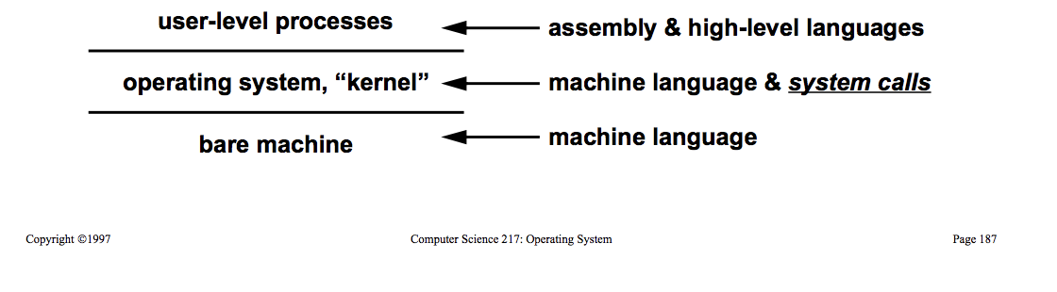
Words that i didn’t know
So you may not too
Privileged Instruction
Something that needs to be ran in kernel mode
Initiate I/O
Switch state vectors or contexts
Load/save from protected memory
@schristoff25
Notes:
And what is a privileged instruction?
Something I found important is how a virtual machine handles privileged instructions, which at first I didn’t know what those were! A privileged instruction is something that needs the processor to be ran in kernel mode, this could be a system call, or something else.

Slide 14
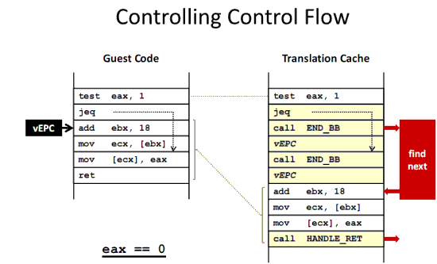
Words that i didn’t know
So you may not too
Binary Translation
Takes the code that the Guest OS wants to run in Kernel Mode and translate it’s to be safe for other guest OSes and the hypervisor
@schristoff25
Notes:
When something needs to be executed in kernel mode something called binary translation occurs.
This means that the guest code is modified to be safe to run in kernel mode.

Slide 15
How do they work?
Hold onto your seats..
Hardware Assisted Virtualization
Full Virtualization
Paravirtualization
Guest OS thinks it is alone
Host OS simulates what the Guest OS thinks is hardware
Relies on binary translation to trap and execute sensitive instructions
Example: VMWare
Guest OS speaks to underlying hardware
Enables virtualization on hardware that does not allow hardware assisted virtualization
Example: Xen, xHyve
Unmodified Guest
Uses processor extensions to emulate privileged instructions in the guest
Examples: VMWare or Xen on specific platforms
@schristoff25
Notes:
In Full Virtualization the Guest Operating System thinks it is alone - so when it would like to execute a privileged instruction it traps to the hypervisor and uses dynamic binary translation to process and execute the instruction. In Full Virtualization, all hardware is is emulated.
In Paravirtualization the guest operating system is modified to be able to process those privileged instructions via a special API that it uses to talk to the hypervisor
In Hardware Assisted Virtualization the processor has extensions to support specific privileged instructions for the guest.

Slide 16
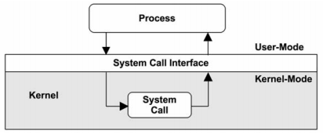
Let’s take a look
Source: https://notes.shichao.io/spec/ch3/
Notes:
let’s take a step back - how does this work on my typical machine?
Well - say we have a process that calls to the open() system call.
That will go to the system call interface, which will figure out what exactly that system call needs.
That will go into Kernel Mode, which will use a table to figure out what that system call is, and the routine that needs to be ran.
Once that is complete, the output goes back up.

Slide 17
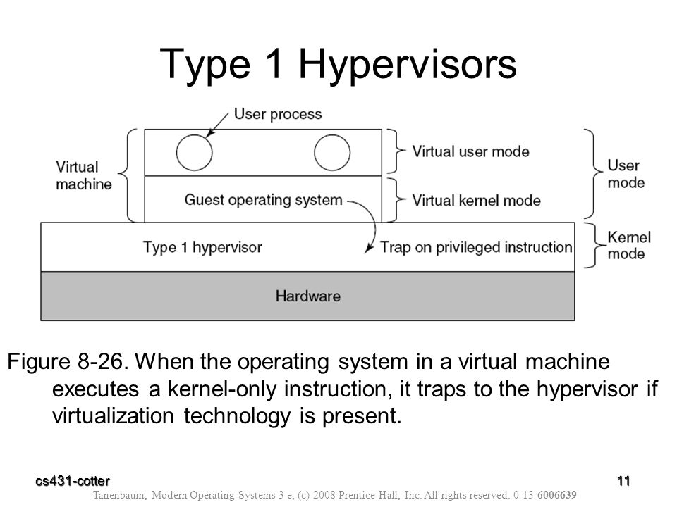
Let’s take a look
Notes:
Just like there are many different types of virtualization, there are different types of hypervisors.
A type One Hypervisor runs on bare metal machine.
The guest operating system believes it is running in kernel mode, but is actually running in user mode. When the hypervisor receives an instruction it inspects it to see if it was from the guest operating system or a user program in the virtual machine.
So, If it comes from the guest operating system then it arranges for the instruction to be carried out. If the instruction comes from a user program in the virtual machine then it emulates what the real hardware would do when confronted with a sensitive instruction — it either ignores it or it traps to the guest operating system.
For example, the guest application has a sys call that invokes the hypervisor. The hypervisor looks at it - sees it is meant for the guest, the guest OS and invokes the guests trap handler, and then the hypervisor resumes the guest app.

Slide 18
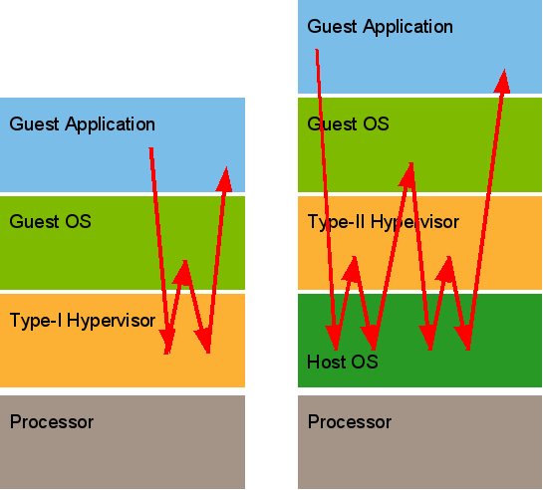
Let’s take a look
Source: https://microkerneldude.wordpress.com/2009/03/23/virtualization-some-get-it-some-dont/
Notes:
A type two hypervisor runs off the host operating system, taking care of the guest operating system. Here the trap is invoked at the host operating system. When the host operating systems sees it’s an event for the guest operating system, it invokes the hypervisor, the hypervisor in return asks for control for the guest OS. The guest delivers the services, and asks to return to it’s app, which traps to the host operating system, which then goes to the hypervisor, and back up to resuming the application.

Slide 19
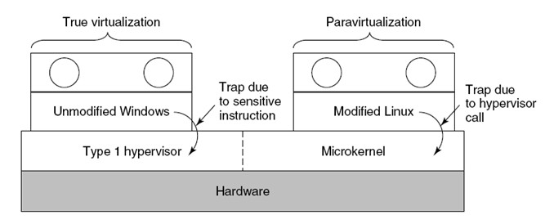
Let’s take a look
Notes:
With paravirtualization all sensitive instructions are hypervisor calls, which makes the guest operating system act like a program, and the hypervisor acts like an operating system.
This means the hypervisor must define a set of procedures the guest system can use, effectively creating an API for the guest operating system to talk to the hypervisor.

Slide 20
There are many types of virtualization
VMs are an emulation of a machine
There’s a lot going on in a vm
Full Virtualization, Paravirtualization, Software Virtualization, etc
It takes the underlying hardware and allows it to be used in different ways
The amount of communication the hypervisor has to have is insane!
@schristoff25

Slide 21
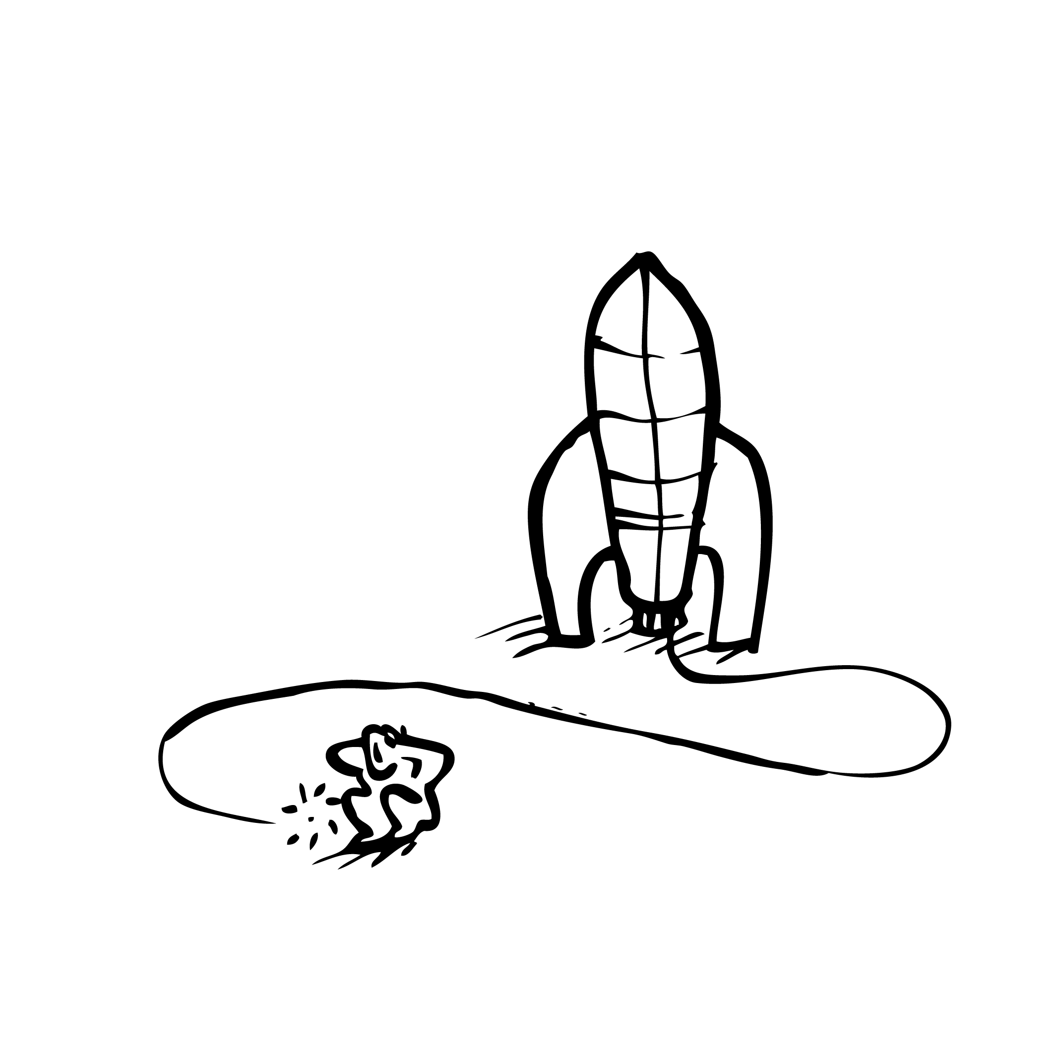
Containers are cool
They’re why we’re here!

Slide 22
Where did it begin? - Containers
2000
FreeBSD Jails
2008
Linux Containers (LXC)
2018
Containers are used widely!
1979
Unix v7, chroot!
2006
Process Containers
2013
Docker, LMCTFY
Notes:
Taking it from the beginning, it started in:
1979 the chroot system call was introduced, which segregated file access for processes.
In 2000, FreeBSD Jails allowed for partitioning a computer system into several smaller systems, called Jails.
Then, in 2006 Google launched Process Containers. Process Containers were renamed Control Groups a year later and were eventually merged into the Linux Kernel.
In 2008 Linux Containers worked using control groups and namespaces, working on a single Linux Kernel without requiring any kind of patches.
Finally in 2013 containers boomed, with Docker, Let me Container that For You, and more.

Slide 23
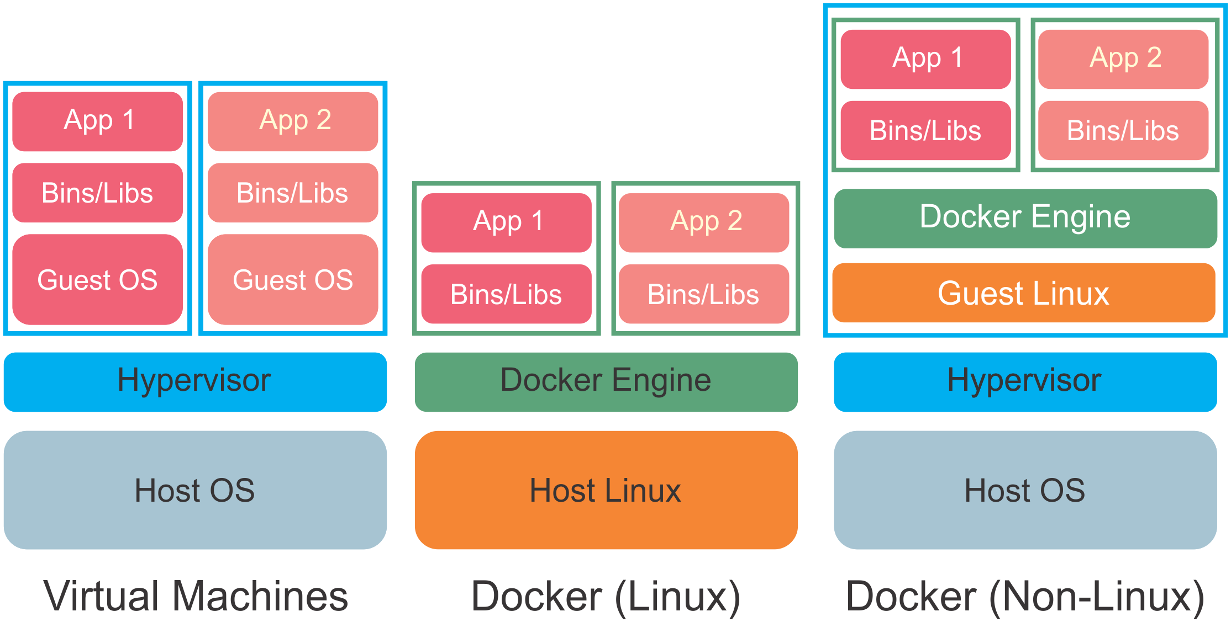
Compared to what we’ve learned...
Source: http://journals.plos.org/plosone/article?id=10.1371/journal.pone.0152686
Notes:
If we wanted to compare containers to the knowledge we just learned about Virtual Machines, we can put it next to a type one hypervisor. Here, the container sits on top of the Linux OS, utilizing those kernel features to run, where a virtual machine has its own operating system in each environment. However, we can also see when we run Docker for Windows, it utilizes Windows Hypervisor to start up a Guest Linux Operating System to run the containers within.

Slide 24
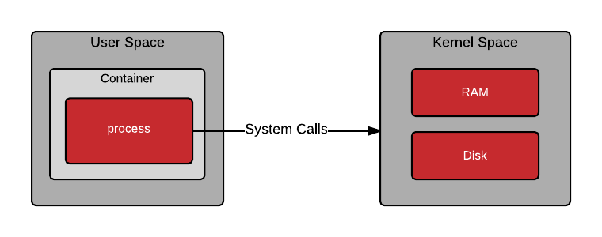
Let’s take a look
Source: https://developers.redhat.com/blog/2018/02/22/container-terminology-practical-introduction/
Notes:
As I’ve stated before - a container is a process. That means when we call open(), it acts how it normally would like if it was outside of the container.

Slide 25
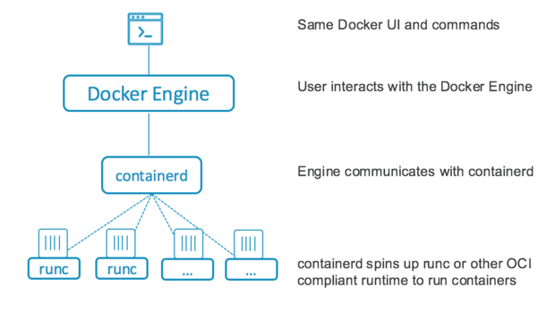
What’s under the hood?
Source: https://stackoverflow.com/questions/41645665/how-containerd-compares-to-runc
Notes:
Breaking down Docker a little further, what does Docker actually do. Well Docker is a container engine and abstracts all the messy stuff like containerd, and runc away so you have an beautiful UI to create what you need.
ContainerD sits below it, a daemon that is in charge of exposing gRPC endpoints, and other low level container management tasks, storage, network attachment, and more.
Below ContainerD sits runC, which is a lightweight binary that interacts with the actual cgroups and namespaces.

Slide 26
What does this stuff do
And why are there so many acronyms
Container Engine
Container Runtime
Actual Containers
Easy to develop on
API driven
Abstracts the messy stuff to make containers fun!
Docker, rkt
Manages container lifecycle
containerd, rktlet
CRI specific:
CRI-O
Dockershim
cri-containerd
Sometimes they don’t close right
Am I talking about tupperware or shipping containers?
Good for holding leftovers that you’ll never eat
@schristoff25
Notes:
A good distinction to be made is one between a container engine and a container runtime. A container engine - like Docker or rkt, is easy to use development tool!
However a container runtime manages image transfer/storage to container execution, supervision and networking.
With Kubernetes becoming a big deal more people wanted to use different runtimes, and so there are CRI specific, or container runtime specific container runtimes that can be used specifically with Kubernetes.

Slide 27
We’re all linux in the end
Namespaces
Control Groups (cgroups)
Limits and virtualize the system resources as a collection of processes
Limits and isolates the resource usage as a collection of processes
Mount
Process ID (PID)
Network
IPC (InterProcess Communication)
UTS
User ID (UID)
CPU
Memory
Disk I/O
Network
@schristoff25
Notes:
I keep talking about these kernel features, namespaces and cgroups. But what do they actually do? Namespaces are in charge of system resources, and currently there are seven different kinds of namespaces. Each process associated with a namespace can only see or use resources associated with the namespace. However, resources are isolated depending on what kind of namespace we use.
In a mount namespace we can mount and unmount file systems without it affecting the host filesystem.
In a PID namespace, your process becomes PID 1, and all subsequent processes are children. Killing the parent PID will eliminate all children.
In a networking namespace you can run programs on any port without conflicting with what may be already running on your machine.
The IPC namespace is used for isolating interprocess communication, like SysV message queues.
UTS namespaces are responsible for system identification. It allows a container to have it’s own hostname independently from the host system.
Finally, the UID or user namepsace allows users inside the namespace to equal different users outside the namespace. This is done through via GID and UID mappings.
Control Groups, or cgroups, takes care of monitoring resource usage. We can thank Google for these. If you want to limit the amount of CPU a process can use, cgroups will do that for you.

Slide 28
Containers are not lightweight virtual machines
Notes:
Now that we have a base understanding on how containers and virtual machines work - you can understand that containers are not light weight virtual machine. Besides - you wouldn’t call a virtual machine a heavy container - would you?

Slide 29
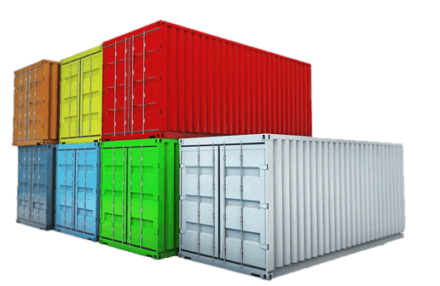
“Containers are an easy to use wrappers
around cgroups and namespaces” - Jess frazelle (I think?)
Notes:
I’m like 90% sure she said this but I can’t find it online anymore but the key point is that containers utilizes these linux features to exist, and without them they would not.

Slide 30
Virtualize Systems
Contain Applications
Notes:
You should contain your application, for ease of testing, for portability, and more. But your systems should be virtualized.

Slide 31
Containers rely on cgroups and namespaces
Containers are not lightweight vms
Containers may not be right for you!
Without them they really couldn’t contain much
VMs will help you emulate, containers will help you ship and deploy!
Some applications cannot be cut into microservices, or your application may not benefit from containers.
@schristoff25

Slide 32
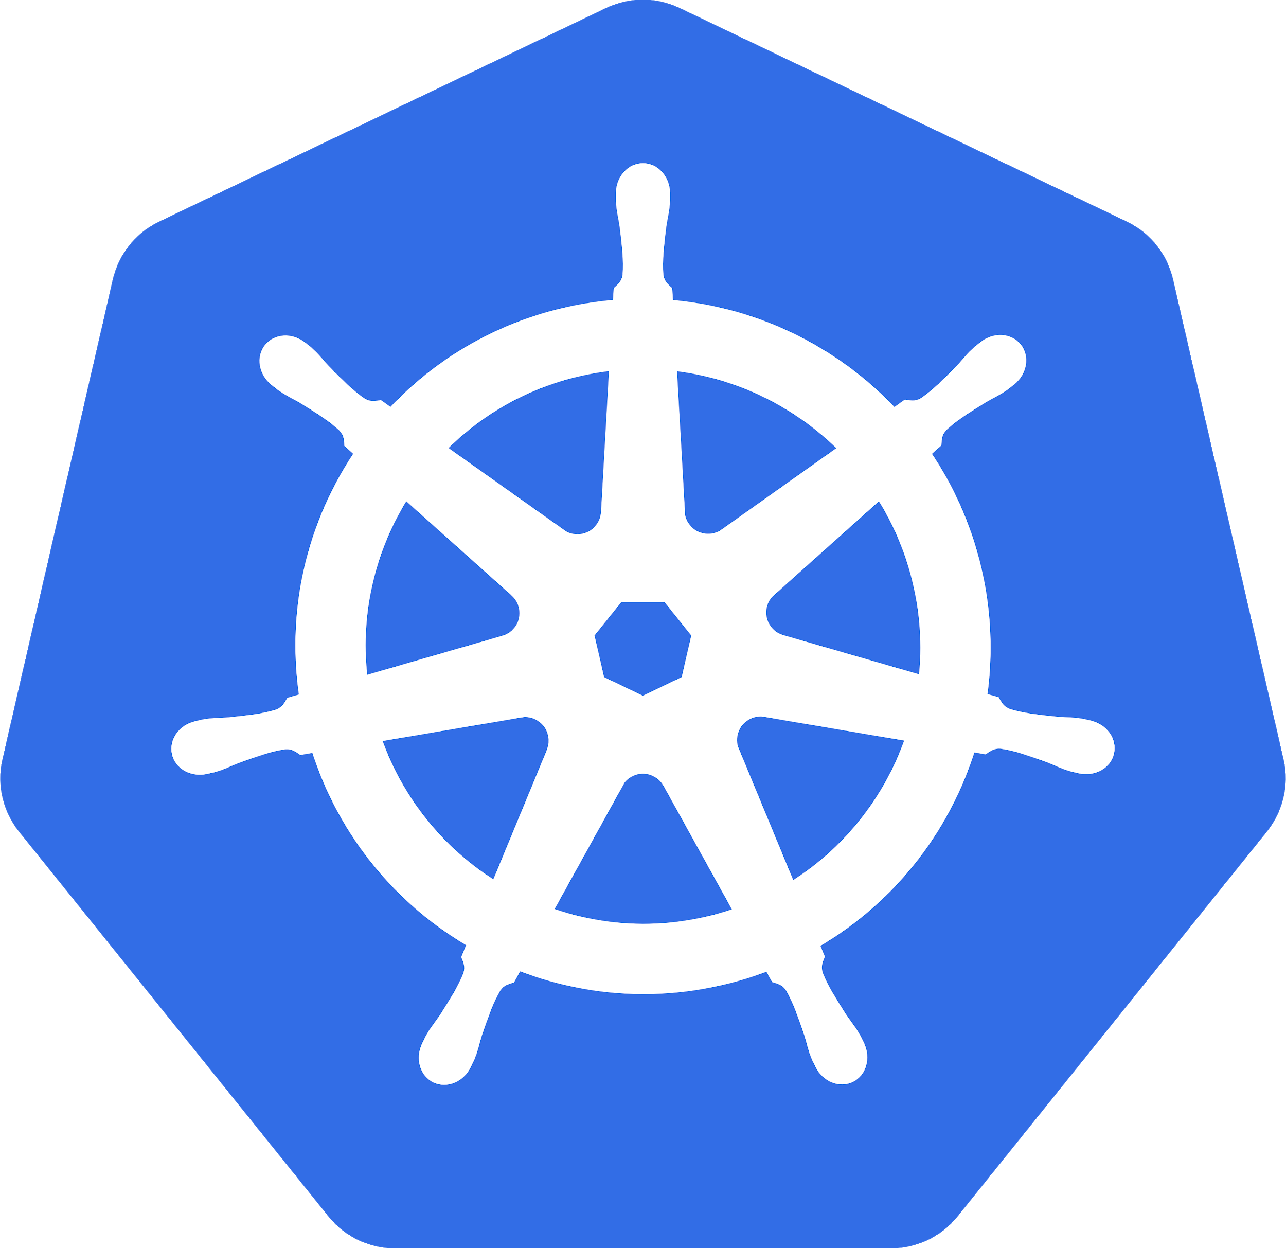
Kubernetes!
It’s important too

Slide 33

What is it?
Everyone needs a babysitter…
Notes:
If by now you don’t know what kubernetes is - I’m worried about you. But simply put it is a container orchestration tool, and what’s cool about it, and other things like it, is it is a baby sitter for your workloads!

Slide 34
What are their strengths?
Swarm
Kubernetes
Nomad
Made by Docker
Tightly integrated with Docker
Up to 1,000 nodes
Cluster management, scheduling, service discovery, and more!
1,000+ contributors
Up to 5,000 nodes
Only provides cluster management and scheduling
Follows Unix philosophy
Simple - single binary
5,000+ nodes
@schristoff25
Notes:
There’s more than these three, I’m excluding mesos and I’m sorry. But to briefly cover some of these tools I chose Swarm, Kubernetes, and Nomad. Swarm was made by Docker and therefore runs very closely with all Docker, Docker Compose, and more. It can run up to 1,000 nodes, and Docker just released their Docker EE 2.0 product which ships with Kubernetes and Swarm.. In case you need to run them together, or you’re switching from one to another. Docker Swarm is great for people who love the Docker UI.
Then there’s Kubernetes, which comes with a horde of features that you can try out - and there’s a lot of different providers to try out too. I feel like Kubernetes is a lot of fun to test what is great for you.
Lastly, Nomad, my personal favorite. Nomad follows the Unix philosophy and is simple and clear. It just wants to schedule your workloads, and that it does. If you need service discovery or other things, Hashicorp has a whole suite of tools.
What I want to get at here are there are many different tools, and it’s not a war between them, but more what is best for you.

Slide 35
Contain applications, virtualize systems
Containers != LIghtweight vms
Containers may not be right for you
@schristoff25
Notes:
So what should you remember here?
You should contain your application, for ease of testing, for portability, and more. But your systems should be virtualized.
Containers are not lightweight virtual machines, they act completely different!
And depending on the needs of your company, your engineering team, your application, containers may not be right for you. Your application may be best in just a traditional VM depending on how it needs to handle state, or perhaps you’re running it on Windows!

Slide 36

When do i use this?
Examples please!
@schristoff25
Notes:
Originally I was going to give a bunch of examples of things that shouldn’t be in virtual machines and things that should be. This whole talk is supposed to show the strengths of these technologies so that they can be used “correctly”.
But then I started at Cloudreach and realized that there is a lot more variables then how your application is built, or what language it is using.
Sometimes the right thing and the best thing are two different options, and it’s up to you, and your team, to assess what the “best” thing is.
So - why are we here, at KubeCon? I think I figured it out. There’s a lot of information and tools and things to keep up with, it’s constantly changing and more things are being added. KubeCon is a great brain dump of information for you to start figuring out the problems that exist in your company. But it’s just the start, there’s a lot of tests that lie ahead.

Slide 37
QUestions? Comments? feedback?
tinyurl.com/kubeconqa

